Slide 1
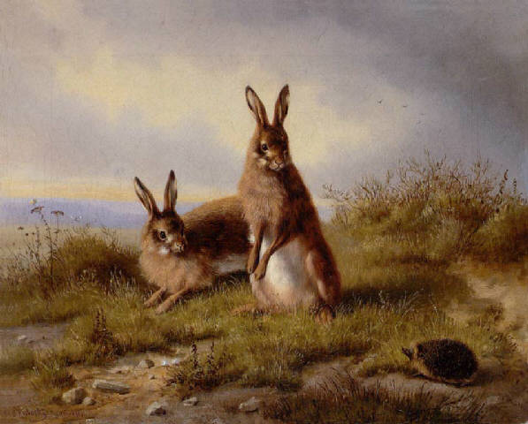
Exploring Growth
How fast do rabbits reproduce?
picture: Zwei Kaninchen und ein Igel
author: Carl Oswald Rostosky (1839-1868); Public Domain

Slide 2
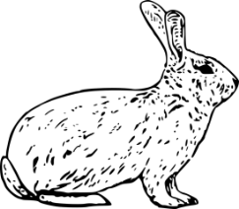
year 0

Slide 3
year 0 year 1

Slide 4
year 0 year 1 year 2

Slide 5
year 0 | year 1 | year 2 | year 3

Slide 6
year 4

Slide 7
year | number of rabbits
year 0 | 1
year 1 | 5
year 2 | 25
year 3 | 125
year 4 | 625
year 5 | 3 125
year 6 | 12 625
year 7 | 78 125
year 8 | 390 625
year 9 | 1 953 125
year 10 | 9 765 625
… | …
year 20 | 95 367 431 640 625

Slide 8
Except where otherwise noted, this work is licensed under the Creative Commons Attribution 4.0 International License. To view a copy of this license, visit http://creativecommons.org/licenses/by/4.0/

